Slide 1
MIXTURES and
PURE SUBSTANCES

Slide 2
LEARNING INTENTIONS

Slide 3
LEARNING INTENTIONS
You will watch a demonstration on magnetic separation
You will watch a demonstration on filtration
You will plan an investigation into separating a mixture using THREE separation techniques

Slide 4
MAGNETIC SEPARATION

Slide 5
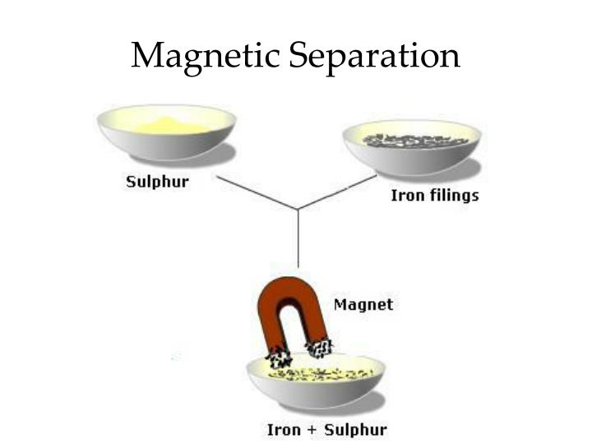

MAGNETIC SEPARATION

Slide 6
FILTRATION

Slide 7
FILTRATION

Slide 8
EVAPORATION

Slide 9
EVAPORATION

Slide 10
TASKS TODAY
In your GROUP – write down your METHOD (List of instructions) that you will follow to SEPARATE SAND – SALT – IRON FILINGS
Your report will be a VIDEO sharing your process and results – this video will be shown in class on MONDAY 19th AUGUST

